Slide 1

CSE-4101 Artificial Intelligence
Search Strategy
Chapter-2

Slide 2
Today’s class
Search
Goal-based agents
Representing states and operators
Example problems
Generic state-space search algorithm
Specific algorithms
Breadth-first search
Depth-first search
Uniform cost search
Depth-first iterative deepening
Example problems revisited

Slide 3
Search Problem
The search problem is to find a sequence of actions which transforms the agent from the initial state to a goal state g∈G. A search problem is represented by a 4-tuple {S, s⁰, A, G}.
S: set of states
s⁰ ∈ S : initial state
A: S􀃆 S operators/ actions that transform one state to another state
G : goal, a set of states. G ⊆ S

Slide 4
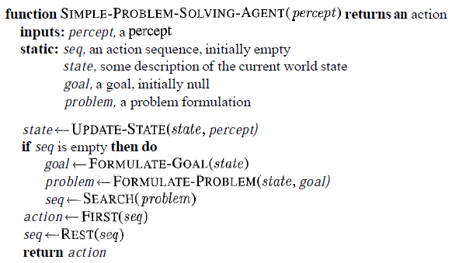
A simple problem-solving agent
It first formulates a goal and a problem,
Searches for a sequence of actions that would solve the problem, and executes actions
One at a time. When this is complete, it formulates another goal and starts over.
When it is executing the sequence it ignores its percepts: it assumes that the solution it has found will always work.

Slide 5
Problem formulation/Searching process
The generic searching process can be very simply described in terms of the following steps:
Do until a solution is found or the state space is exhausted.
1. Check the current state
2. Execute allowable actions to find the successor states.
3. Pick one of the new states.
4. Check if the new state is a solution state
If it is not, the new state becomes the current state and the process is repeated

Slide 6
Basic concepts
State: finite representation of the world that you want to explore at a given time
.
An initial state is the description of the starting configuration of the agent/The problem at the beginning.
Goal state: desired end state (can be several)/ test to determine if the goal has been reached.
An action or an Operator: a function that transforms a state into another (also called rule, transition, successor function, production, action).
Path Cost: The cost of a plan is referred to as the path cost
The path cost is a positive number, and a common path cost may be the sum of the costs of the steps in the path.
A problem can be defined formally by four components

Slide 7
Search Problem
The sequence of actions is called a solution plan.
Solution path is a path from the initial state to a goal state.
P = {a⁰, a¹, … , a^{N}} which leads to traversing a number of states {s⁰, s¹, … , s^{N+1}∈G}.
A sequence of states is called a path.
The cost of a path is a positive number.
In many cases the path cost is computed by taking the sum of the costs of each action.

Slide 8
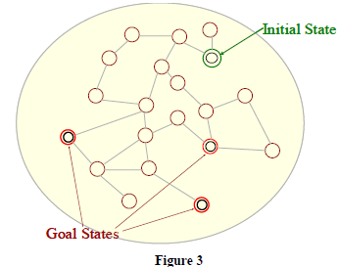
Illustration of a search process
We will now illustrate the searching process with the help of an example. Consider the problem depicted in Figure
Figure-1
s⁰ is the initial state.
The successor states are the adjacent states in the graph.
There are three goal states.

Slide 9
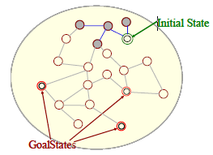
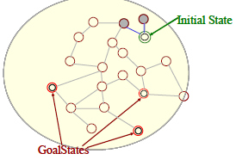
Figure-3
Figure-2
The two successor states of the initial state are generated.
The successors of these states are picked and their successors are generated.

Slide 10
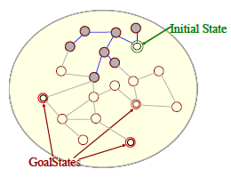
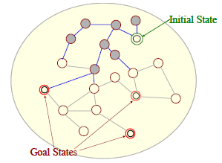
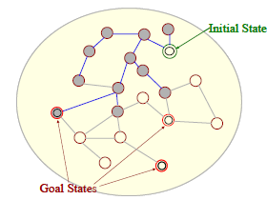
Figure-5
Figure-4
Successors of all these states are generated.
The successors are generated.
A goal state has been found.
Figure-6

Slide 11
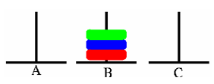
Example problem: Pegs and Disks problem
Consider the following problem. We have 3 pegs and 3 disks.
Operators: one may move the topmost disk on any needle to the topmost position to any other needle
In the goal state all the pegs are in the needle B as shown in the figure below..

Slide 12

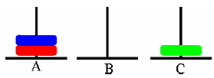
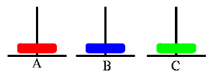
The initial state is illustrated below.
Now we will describe a sequence of actions that can be applied on the initial state.
Step 1: Move A → C
Step 2: Move A → B

Slide 13


Step 3: Move A → C
Step 4: Move B→ A
Step 5: Move C → B
Step 6: Move A → B

Slide 14
Step 7: Move C→ B

Slide 15
Another search problem :8 puzzle
In the 8-puzzle problem we have a 3×3 square board and 8 numbered tiles.
The board has one blank position.
Bocks can be slid to adjacent blank positions.
We can alternatively and equivalently look upon this as the movement of the blank position up, down, left or right.
The objective of this puzzle is to move the tiles starting from an initial position and arrive at a given goal configuration.

Slide 16
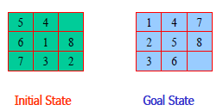
Problem Definition - Example, 8 puzzle
In the 8-puzzle problem we have a 3×3 square board and 8 numbered tiles
States: A state is a description of each of the eight tiles in each location that it can occupy.
Operators/Action: The blank moves left, right, up or down
Goal Test: The current state matches a certain state (e.g. one of the ones shown on previous slide)
Path Cost: Each move of the blank costs 1

Slide 17
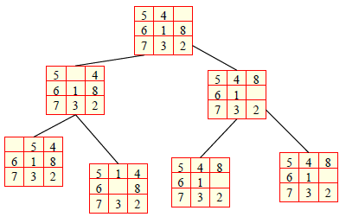
Problem Definition - Example, 8 puzzle
A small portion of the state space of 8-puzzle is shown below. Note that we do not need to generate all the states before the search begins. The states can be generated when required.

Slide 18
Uninformed Search/Blind Search Control Strategy
Also known as “blind search,” uninformed search strategies use no information about the likely “direction” of the goal node(s)
Do not have additional info about states beyond problem def.
Total search space is looked for solution
No info is used to determine preference of one child over other.
Example: 1. Breadth First Search(BFS), Depth First Search(DFS), Depth Limited Search (DLS)

Slide 19
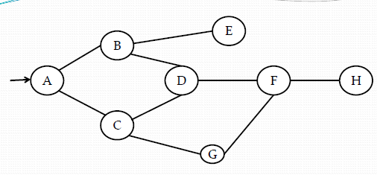
Uninformed Search/Blind Search Control Strategy
State Space without any extra information associated with each state

Slide 20
Breadth First Search (BFS)
Algorithm:
1. Create a variable QUEUE, put the starting node on
Queue and set it to initial state.
2.Loop: Until a Goal State is found or QUEUE is empty:
if nodes is empty then return failure
node := Remove-Front (QUEUE)
if Goal-Test[problem] applied to State(node) succeeds
then return node
new-nodes := Expand (QUEUE,Operators[problem]))
nodes := Insert-At-End-of-Queue(new-nodes)
end

Slide 21
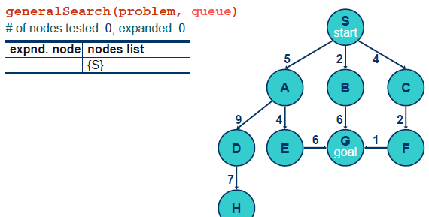
Breadth First Search

Slide 22
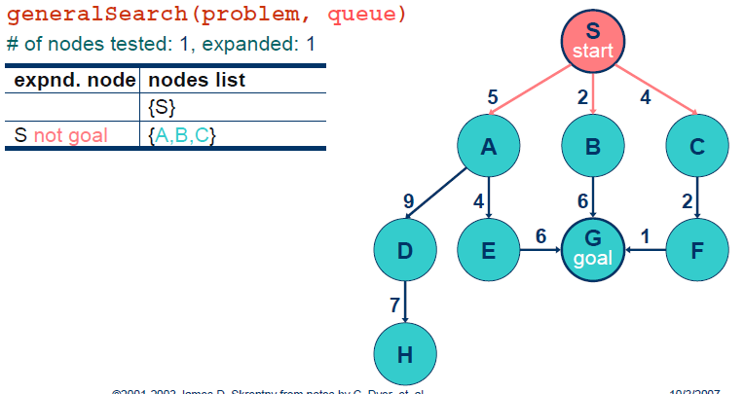

Slide 23
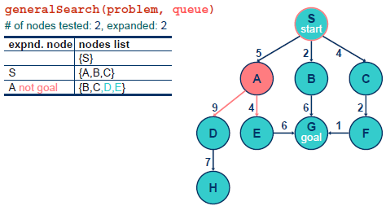

Slide 24
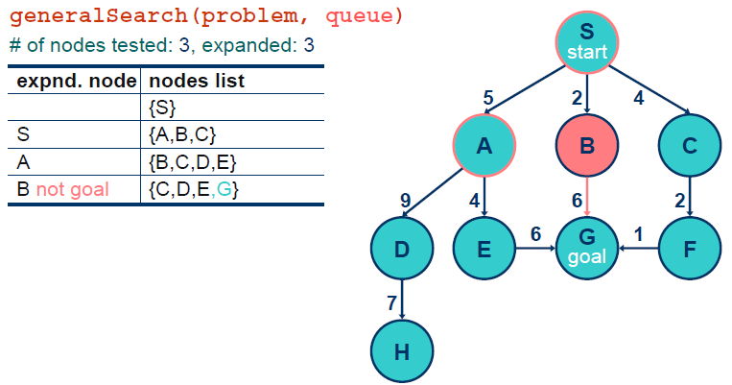

Slide 25
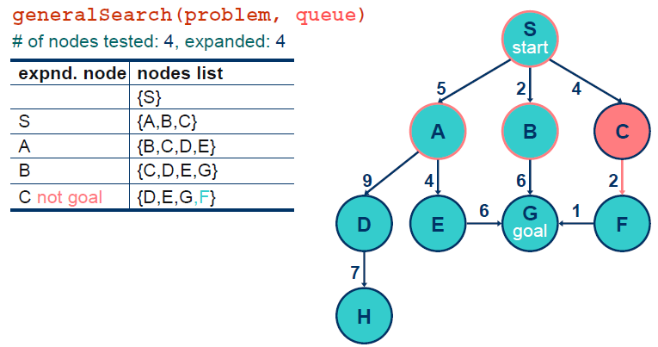

Slide 26
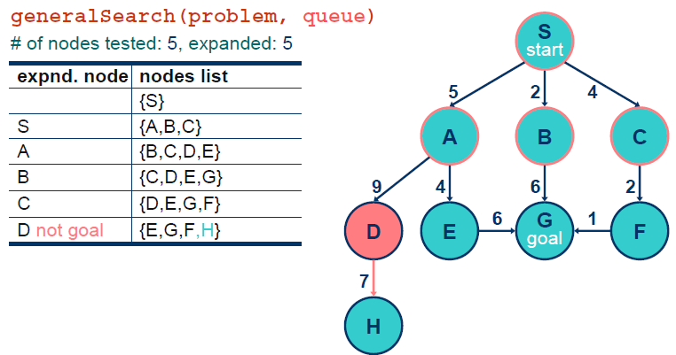

Slide 27
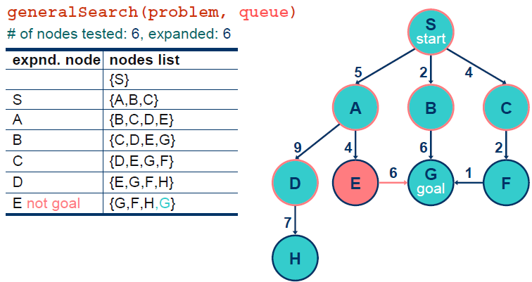

Slide 28
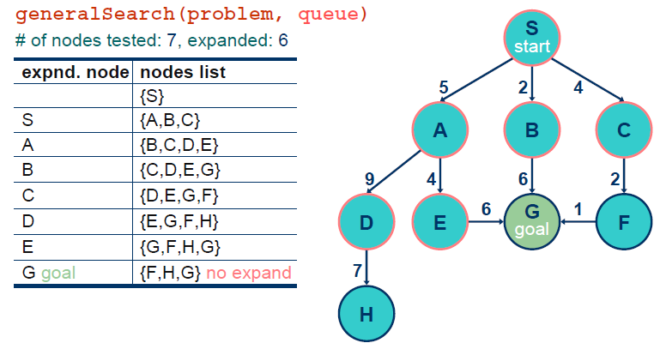

Slide 29
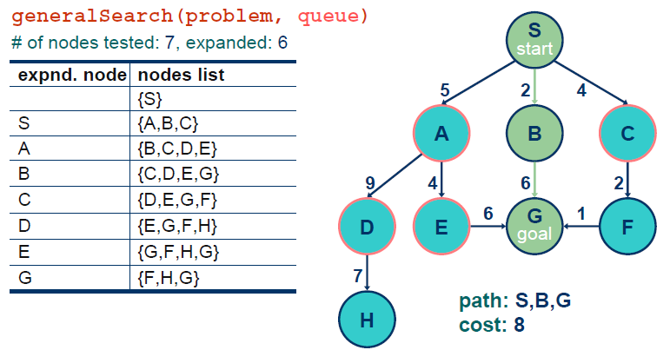

Slide 30
Another Breath-first search
S
A
D
B
D
A
E
C
E
E
B
B
F
11
D
F
B
F
C
E
A
C
G
14
17
15
15
13
G
C
G
F
19
19
17
G
25

Slide 31
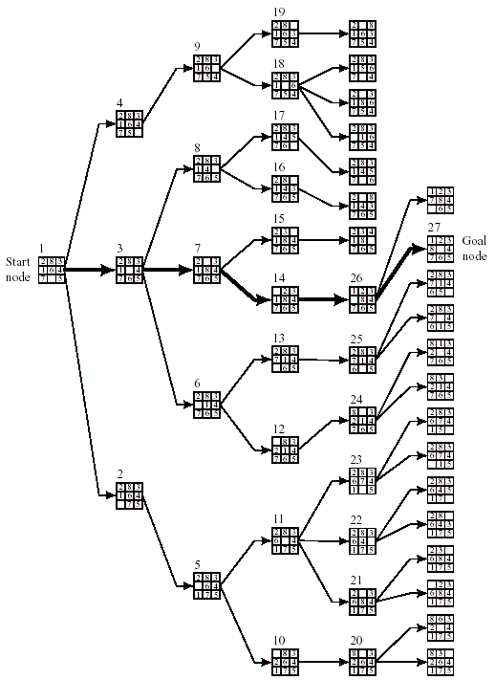
Figure 8.2 Breadth-First Search of the Eight-Puzzle

Slide 32
Advantages of BFS:
1. BFS is a systematic search strategy- all nodes at level n are considered before going to n+1 th level.
2. If any solution exists then BFS guarentees to find it.
3. If there are many solutions , BFS will always find the shortest path solution.
Disadvantages of BFS:
1. All nodes are to be generated at any level. So even unwanted nodes are to be remembered. Memory wastage.
2. Time and space complexity is exponential type- Hurdle.

Slide 33
Depth First Search (DFS)
Algorithm:
1. Create a variable STACK and set it to initial state.
2.Loop: Until a Goal State is found or STACK is empty:
if nodes is empty then return failure
node := Remove-Front (STACK)
if Goal-Test[problem] applied to State(STACK) succeeds
then return node
new-nodes := Expand (STACK,perators[problem]))
nodes := Insert-At-Front-of-Stack(new-nodes)
end

Slide 34
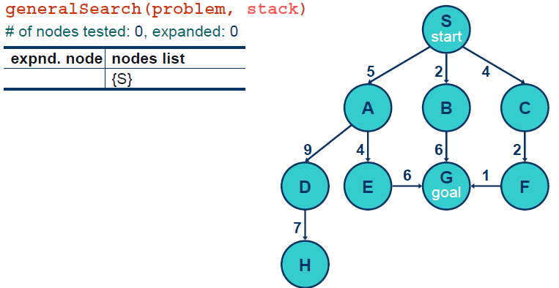
Depth-first

Slide 35
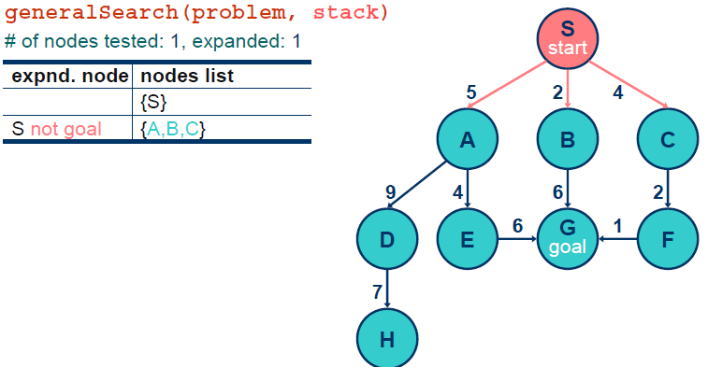

Slide 36
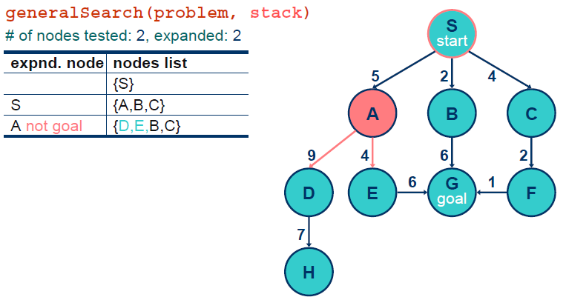

Slide 37
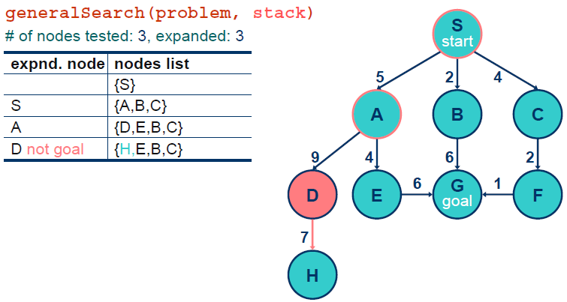

Slide 38
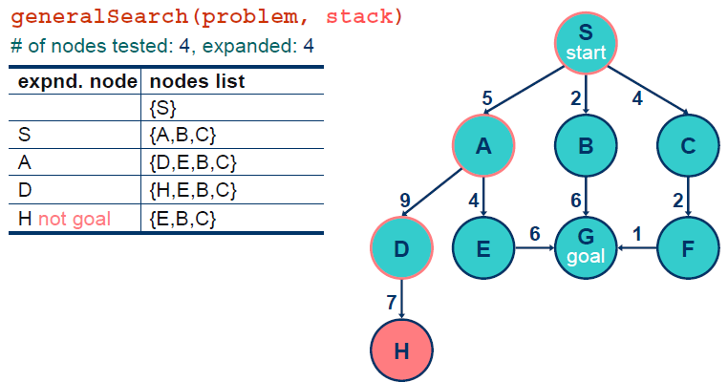

Slide 39
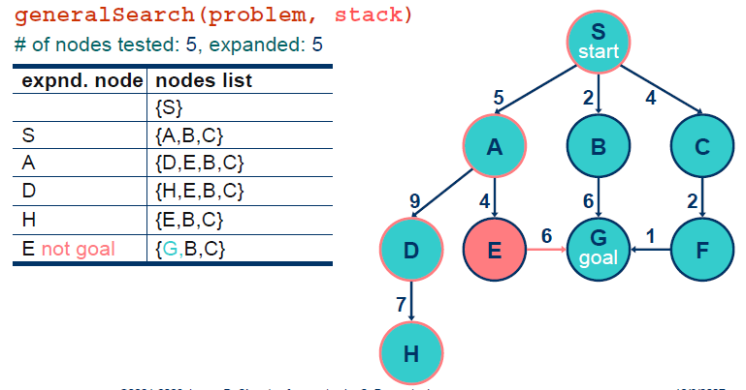

Slide 40
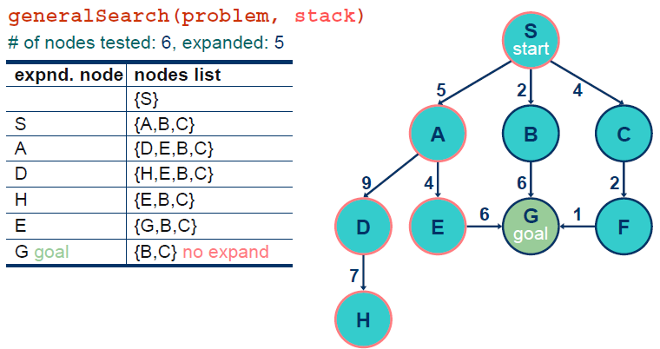

Slide 41
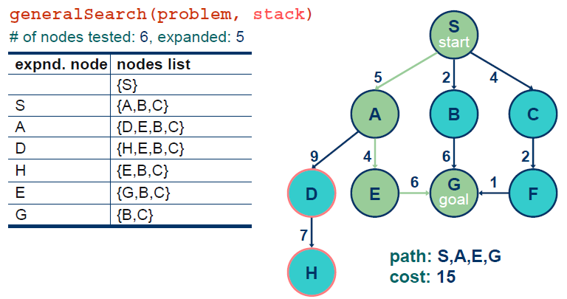

Slide 42
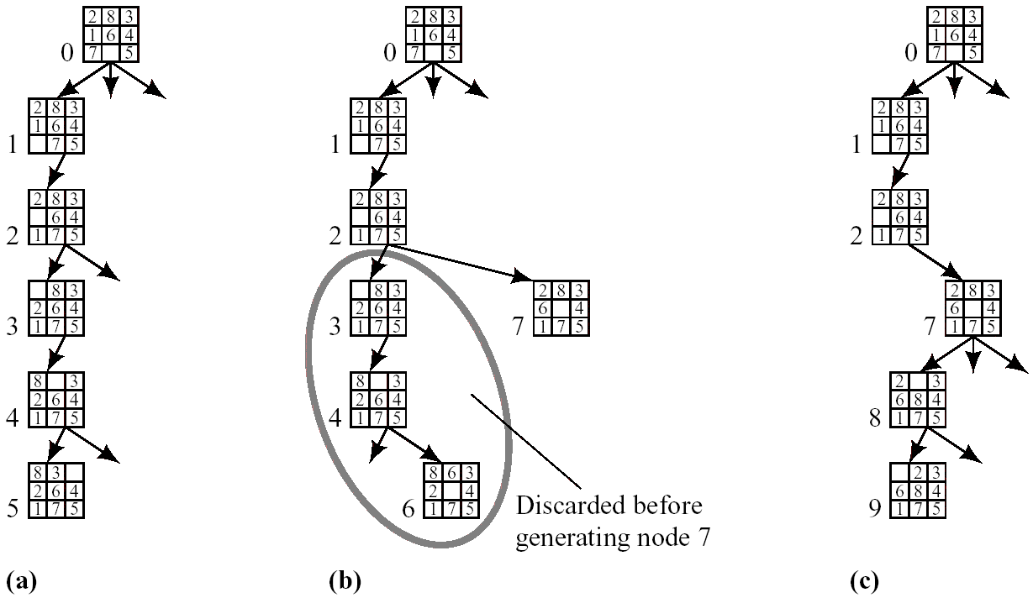
4. Depth-First or Backtracking Search (Cont’d)
8-puzzle example
Depth bound: 5
Operator order: left → up → right → down
Figure 8.3 Generation of the First Few Nodes in a Depth-First Search

Slide 43
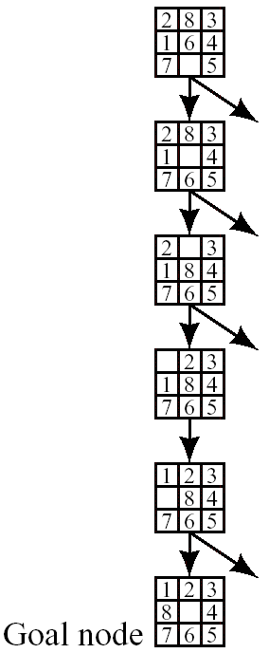
4. Depth-First or Backtracking Search (Cont’d)
The graph when the goal is reached in depth-first search

Slide 44
Advantages of DFS:
1. Memory requirements in DFS are less compared to BFS as only nodes on the current path are stored.
2. DFS may find a solution without examining much of the search space of all.
Disadvantages of BFS:
1. This search can go on deeper and deeper into the search
space and thus can get lost. This is referred to as blind
alley.!

Slide 45
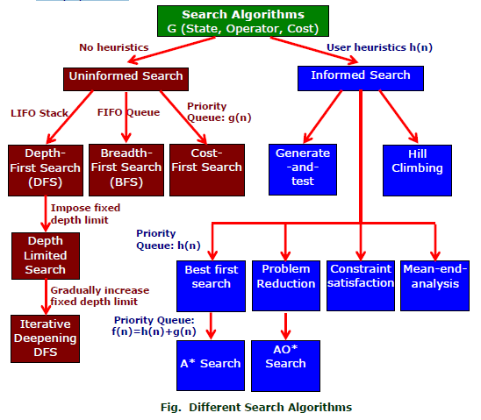

Slide 46
Informed Search
Also Called heuristic or intelligent search,
Uses information about the problem to guide the search,
Usually guesses the distance to a goal state and therefore efficient,
but the search may not be always possible.
The search so guided are called heuristic search and the methods used are called heuristics.

Slide 47
Advantage of Informed Search
A search strategy which searches the most promising branches of the state-space first can:
find a solution more quickly,
find solutions even when there is limited time available,
Often find a better solution, since more profitable parts of the state-space can be examined, while ignoring the unprofitable parts.
A search strategy which is better than another at identifying the most promising branches of a search-space is said to be more informed.

Slide 48
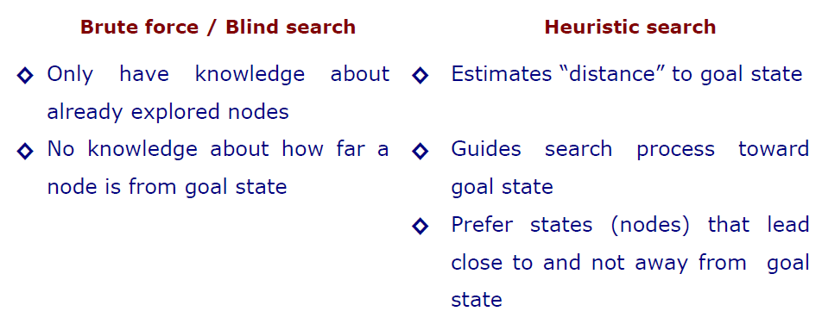
Heuristic Search Compared with other Search

Slide 49
Heuristics
Algorithm
First, generate a possible solution which can either be a point in the problem space Or a path from the initial state.
Then, test to sea if this possible solution is a real solution by comparing the state
Reached with the set of goal states.
If it is real solution, return, else repeat from the first again.

Slide 50
Heuristics Search Technique
Example of Heuristic Function
A heuristic function at a node n is an estimate of the optimum cost from the current node to a goal. It is denoted by h(n).
h(n) = estimated cost of the cheapest path from node n to a goal node
Example 1: We want a path from Kolkata to Guwahati
Heuristic for Guwahati may be straight-line distance between Kolkata and Guwahati
h(Kolkata) = euclideanDistance(Kolkata, Guwahati)

Slide 51
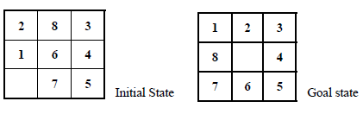
Example 2: 8-puzzle: Misplaced Tiles Heuristics is the number of tiles out of place.
The first picture shows the current state n, and the second picture the goal state.h(n) = 5 because the tiles 2, 8, 1, 6 and 7 are out of place.
Manhattan Distance Heuristic: Another heuristic for 8-puzzle is the Manhattan distance heuristic. This heuristic sums the distance that the tiles are out of place. The distance of a tile is measured by the sum of the differences in the x-positions and the y-positions.
For the above example, using the Manhattan distance heuristic,
h(n) = 1 + 1 + 0 + 0 + 0 + 1 + 1 + 2 = 6

Slide 52
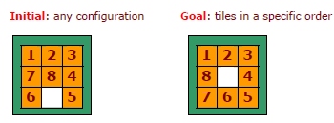
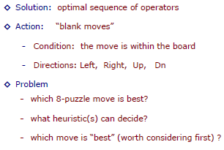

Slide 53
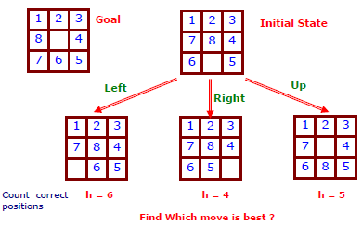
Action
Three possible moves –left,up,right

Slide 54
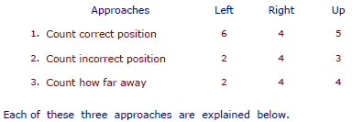
Apply Heuristic
Three different Approaches
-count correct position of each tile, compare to goal state.
-count incorrect position of each tile, compare to goal state.
-count how far away each tile is from it is correct position.

Slide 55
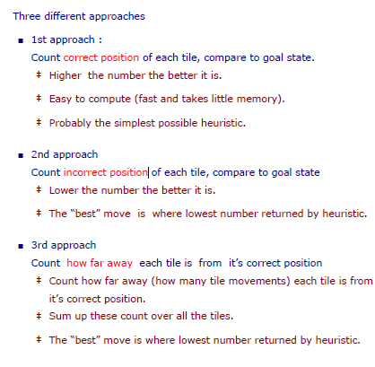

Slide 56
Best First Search
Idea: use an evaluation function f(n) for each node
f(n) provides an estimate for the total cost.
Expand the node n with smallest f(n).
Implementation:
Order the nodes in fringe increasing order of cost.
The algorithm maintains a priority queue of nodes to be explored.
A cost function f(n) is applied to each node.
The nodes are put in OPEN in the order of their f values.
Nodes with smaller f(n) values are expanded earlier. The generic best first search algorithm is outlined below.

Slide 57
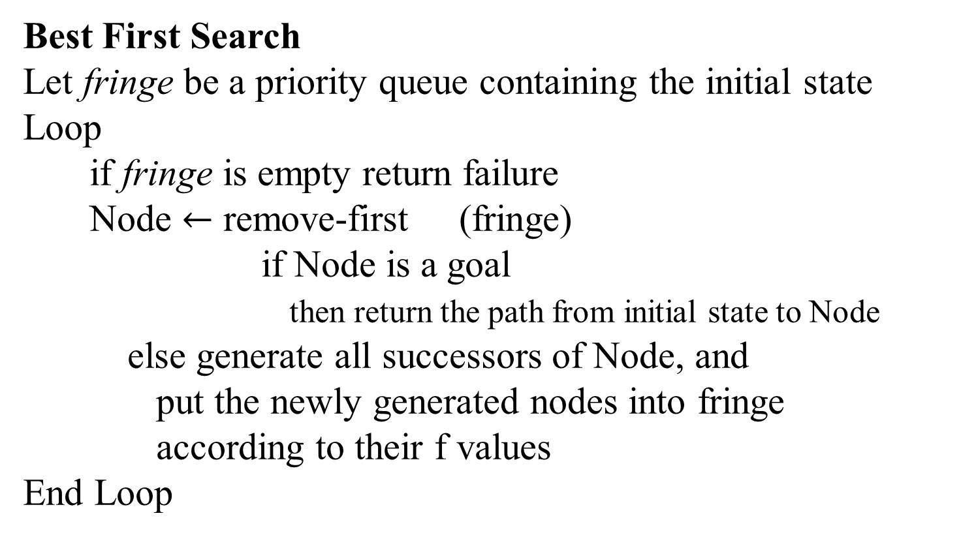
Algorithm:
Best First Search
Let fringe be a priority queue containing the initial state
Loop
if fringe is empty return failure
Node $←$ remove-first (fringe)
if Node is a goal
then return the path from initial state to Node
else generate all successors of Node, and
put the newly generated nodes into fringe
according to their f values
End Loop

Slide 58
Greedy Best First Search
In greedy search, the idea is to expand the node with the smallest estimated cost to reach the goal.
We use a heuristic function f(n) = h(n)
h(n) estimates the distance remaining to a goal.
e.g., h_{SLD}(n) = straight-line distance from n to Bucharest Greedy best-first search expands the node that appears to be closest to goal

Slide 59
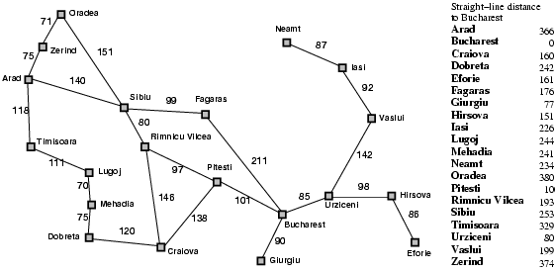
Romania with step costs in km

Slide 60

Greedy best-first search example

Slide 61
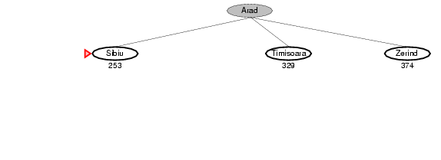
Greedy best-first search example

Slide 62
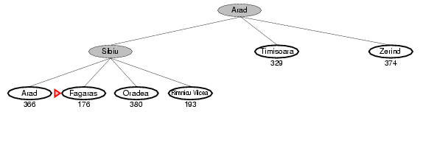
Greedy best-first search example

Slide 63
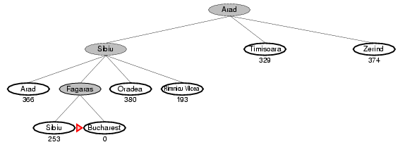
Greedy best-first search example

Slide 64
Properties of greedy best-first search
Complete? No – can get stuck in loops, e.g., Iasi → Neamt → Iasi → Neamt →
Time? O(b^{m}), but a good heuristic can give dramatic improvement
Space? O(b^{m}) -- keeps all nodes in memory
Optimal? No

Slide 65
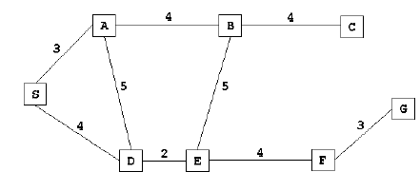
Figure 2 is an example of a route finding problem. S is the starting state, G is the goal state.
Figure 2
Let us run the greedy search algorithm for the graph given in Figure 2. The straight line distance heuristic estimates for the nodes are shown in Figure

Slide 66
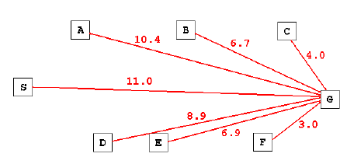
Figure 3

Slide 67

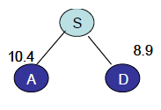
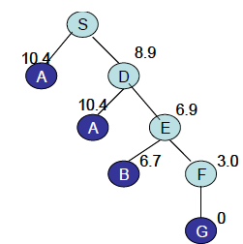


Step 1: S is expanded. Its children are A and D.
Step 2: D has smaller cost and is expanded next.

Slide 68
A* Search
Idea: avoid expanding paths that are already expensive
A* is a best first search algorithm with
f(n)=g(n)+h(n).
Where
g(n)=sum of edge costs from start to n (distance current node from start)
h(n)=estimate of lowest cost path from goal to current node.
f(n)=actual distance so far estimated distance remaining.
Best First search has f(n)=h(n)
We can prove that if h(n) is admissible, then the search will find and optimal solution

Slide 69
The A* Algorithm
Input:
– QUEUE: Path only containing root
Algorithm:
– WHILE (QUEUE not empty && first path not reach goal) DO
Remove first path from QUEUE
Create paths • to all children
Reject paths with loops
Add paths and sort QUEUE (by f = cost + heuristic)
IF QUEUE contains paths: P, Q
AND P ends in node Ni && Q contains node Ni
AND cost_P ≥ cost_Q
THEN remove P
– IF goal reached THEN success ELSE failure

Slide 70

A* search example

Slide 71

A* search example

Slide 72

A* search example

Slide 73

A* search example

Slide 74

A* search example

Slide 75

A* search example

Slide 76

A* search example

Slide 77

A* search example

Slide 78

A* search example

Slide 79

A* search example

Slide 80
A* search example

Slide 81

A* search example

Slide 82

A* search example

Slide 83

A* search example

Slide 84

A* search example

Slide 85

A* search example

Slide 86

A* search example

Slide 87

A* search example

Slide 88

A* search example

Slide 89

A* search example

Slide 90

A* search example

Slide 91

A* search example

Slide 92

A* search example

Slide 93

A* search example

Slide 94

A* search example

Slide 95

A* search example

Slide 96

A* search example

Slide 97

A* search example

Slide 98
9.2.2 Admissibility of A*
Conditions that guarantee A* always finds minimal cost paths
Each node in the graph has a finite number of successors
All arcs in the graph have costs greater than some positive amount ε

Slide 99

Optimality of A*
A* expands nodes in order of increasing f value
Gradually adds "f-contours" of nodes
Contour i has all nodes with f=f_{i}, where f_{i} < f_{i+1}

Slide 100
An alternative: IDA*
IDA* = Iterative Deepening A*
Performs a series of depth-first searches, each with a certain cost cut-off.
When the f value for a node exceeds this cut-off, then the search must backtrack.
If the goal node was not found during the search, then more depth-first searches are conducted with higher cut-offs until the goal is found.

Slide 101

IDA* Algorithm
Iterative deepening A* or IDA* is similar to iterative-deepening depth-first, but with the following modifications:
The depth bound modified to be an f-limit
f-bound ôf(S)
• Algorithm:
– WHILE (goal is not reached) DO
• f-bound $←$ôf-limitted_search(f-bound)
– Perform f-limited search with f-bound
(See next slide)

Slide 102

IDA* Algorithm

Slide 103

Problem

Slide 104

IDA* Search

Slide 105

IDA* Search

Slide 106

IDA* Search

Slide 107

IDA* Search

Slide 108

IDA* Search

Slide 109

IDA* Search

Slide 110

IDA* Search

Slide 111

IDA* Search

Slide 112

IDA* Search

Slide 113

IDA* Search

Slide 114

IDA* Search

Slide 115

IDA* Search

Slide 116

IDA* Search

Slide 117

IDA* Search

Slide 118

IDA* Search

Slide 119

IDA* Search

Slide 120

Why do we use IDA*?
IDA* is complete, optimal, and optimally efficient (assuming a consistent, admissible heuristic), and requires only a polynomial amount of storage in the worst case:
IDA* uses very little memory

Slide 121
SMA*
Simplified Memory Bounded A* is a shortest path algorithm based on the A* algorithm.
The main advantage of SMA* is that it uses a bounded memory, while the A* algorithm might need exponential memory.
All other characteristics of SMA* are inherited from A*.

Slide 122

SMA* Algorithm
Optimizes A* to work within reduced memory
• Key Idea:
– IF memory full for extra node (C)
– Remove highest f-value leaf (A)
– Remember best-forgotten child in
each parent node (15 in S)
E.g. Memory of 3 nodes only

Slide 123

SMA* Algorithm

Slide 124

SMA* Algorithm

Slide 125

SMA* Algorithm

Slide 126


SMA* By Example
Perform SMA* (memory: 3 nodes) on the following figure.

Slide 127


SMA* By Example

Slide 128


SMA* By Example

Slide 129

SMA* By Example

Slide 130

SMA* By Example

Slide 131

SMA* By Example

Slide 132

SMA* By Example

Slide 133

SMA* By Example

Slide 134

SMA* By Example

Slide 135

SMA* By Example

Slide 136
Confession
It is possible that some sentences or some information were included in these slides without mentioning exact references. I am sorry for violating rules of intellectual property. When I will have a bit more time, I will try my best to avoid such things.
These slides are only for students in order to give them very basic concepts about the giant, “Networking”, not for experts.
Since I am not a network expert, these slides could have wrong/inconsistent information…I am sorry for that.
Students are requested to check references and Books, or to talk to Network engineers.

